Slide 1
Designing For Startup/Shutdown
No Book Chapter
Terry A. Ring
Chemical Engineering
University of Utah

Slide 2
Startup/Shutdown is the most dangerous time in the life of a chemical plant!
Typically there is a startup recipy that is followed very carefully
Shutdown
Emergency Shutdown
Depends upon where the problem is as to how the plant will be shut down.
Much of process vessel contents are sent to vent
Planned Shutdown
Carefully followed procedure
Most of process vessel contents are captured for sale or reuse.

Slide 3
Startup
Plant is newly built – first startup
Long and involved process
Identifying surprises in construction
Identifying bottlenecks
Plant getting ready to run again for 330 days
You want this to go quickly and smoothly

Slide 4
Distillation Plant Startup Problem Statement HW 4
Using distillation heuristics 3 (H3 - remove greatest molar flows early in sequence) and 4 (H4 - sequence in order of decreasing relative volatilities) determine the most economical sequence in terms of the annual cost of the distillation sequence for this stream assuming a ≥98% overall recovery of each component with a mole percentage composition of ≥98%.

Slide 5
What Happens At Startup?
C3
tC4
1.72 Mpa
17 bar
nC4
tC5
nC5

Slide 6
Before Startup, How do you assure there are no leaks?
Any Implications on design?

Slide 7
How do you assure there are no leaks?
Did you design in the Isolation valves?
Do you have a pressure gage installed?
What gas are you going to use?
Do you have adequate onsite storage for this gas?

Slide 8
Startup Sequence
Add mix to B1 (initial charge)
Run at infinite recycle to warm up equipment
Did you design valving to run at infinite recycle?
Did you add a storage tank for this mixture?
Add mix to B2
Run at infinite recycle to warm up equipment
Add mix to B3
Run at infinite recycle to warm up equipment
Add mix to B4
Run at infinite recycle to warm up equipment
Then what???

Slide 9
Then
Once all columns are operating at infinite recycle
Start Feed
Set boilup ratio and reflux ratio in B1, B2, B3 and B4 one at a time
Open up the connection valves so that the feed can be separated from B1 to B3 and B4.
Initially product purity is not to spec.
Initial materials are reprocessed
Do you have a tank that can handle all this off spec materal?
Would surge tanks between distillation columns be useful for these initial surging conditions?

Slide 10
You Just Blewup the $171.5 Million Plant!!!
Air was in the columns when it was charged with a fuel
Fuel was then made hot in reboiler.
Fires take place inside the columns-Overheating the steel and welds and melting gaskets.
How to you eliminate air from a vessel and then fill it to start up?
N₂? Do you have a storage tank with that much N₂?
Are lines in place? What Pressure?
Sufficient Pressure Relief Valves – are they set properly, are they the correct size?
Other Options??

Slide 11
Refineries steam the process equipment for days before hydrocarbons are added to remove air.
Implications on Design
Adequate Steam Drains
Adequate Size to the Steam Plant
Summer vs Winter (more) Plant Steaming
What happens if there is a steam over pressurization? HP Steam is 450 psig (30 bar)!
Is the pressure vessel thick enough for this service?
Are the vents adequate for steaming
Are the PRVs correct?
What happens if steam is shut off when vessel is closed or vent is plugged?
What happens if the Steam Plant Breaks Down in Startup and Plant cools off?

Slide 12
Stream Induces Vacuum Collapse
https://www.youtube.com/watch?v=vzenRoxrnm8
https://www.youtube.com/watch?v=Zz95_VvTxZM

Slide 13
Startup Sequence
Add mix to B1 (initial charge)
Run at infinite recycle to warm up equipment
Did you design valving to run at infinite recycle?
Did you add a storage tank for this mixture?
Add mix to B2
Run at infinite recycle to warm up equipment
Add mix to B3
Run at infinite recycle to warm up equipment
Add mix to B4
Run at infinite recycle to warm up equipment
Is this the correct order to turn on the feed flow?
Should the outlet, B3 and/or B4, be opened first? So reverse order is best?
Notes:
What about a pressure build up in the system with no outlet if done in order.

Slide 14
Shutdown
How to do a Planned Shutdown
1.72 Mpa
17 bar
Notes:
Shutoff feed
Shutoff steam to Reboilers but keep conders cooling
Vent the vessel gas contents to flare.
Drain the liquid contents to storage. The products should be salable.

Slide 15
How To Startup this process
Exothermic Rxn

Slide 16
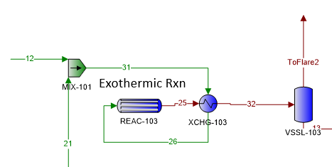
Startup
Start Reactant Flow after steaming or inerting
No recycle
Make sure the control system is set up correctly to handle no recycle
Rxn rate is temp dependent – hot is faster reaction.
Cold reactants will not react!!
How do I get the reactants hot enough to react???
Notes:
Flash and Distillation should be started first, then start the heater and the reactant flow The control system for the heater is to simply hit the outlet T.
Control system for Mixer – CV on 12 flow sensor on 31. This controls flow into reactor. Do you turn flow to full one immediately?

Slide 17
Startup
Start Reactant Flow after steaming or inerting
No recycle
How do I get the reactants hot enough to react???
Need Fired heater on 26 to do the HX of the heat exchanger – size is large
This can be a trim heater when the process is running at steady state but it may be too big so two in parallel might be needed.
Notes:
Flash and Distillation should be started first, then start the heater and the reactant flow The control system for the heater is to simply hit the outlet T.

Slide 18
Startup
How is Flash Vessel Designed?
Notes:
Flash and Distillation should be started first, then start the heater and the reactant flow The control system for the heater is to simply hit the outlet T.

Slide 19
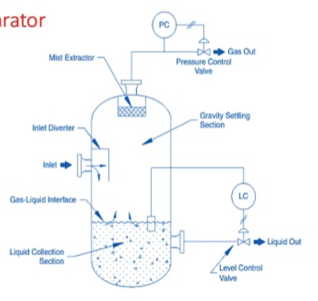
Flash Tank Design
Heat Exchange Possibilities
1) Cooling Heat Exchange Before Inlet
2) Pump around loop with cooling heat exchange in loop and cold shower in tank.
3) Heat exchange inside vessel
No Heat Exchange

Slide 20
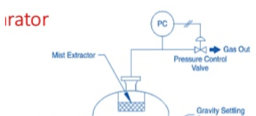
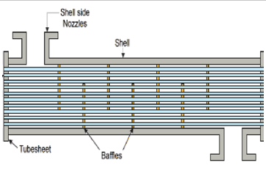
Flash Designs
HX

Slide 21
Startup
How is Flash Vessel Designed?
HX on outlet
Steam or inert the vessel, Start cooling utility to HX
External HX with flow loop and spray in Flash Vessel
Steam or inert the vessel, Charge the flow loop, start cooling Utility, start flow in loop
Notes:
Flash and Distillation should be started first, then start the heater and the reactant flow The control system for the heater is to simply hit the outlet T.

Slide 22
Distillation Startup

Slide 23
Startup
Distillation
Steam or inert the vessel, Charge column, Reboiler and Condenser Utilities turned on, Infinite Recycle to SS, then jump to finite reflux and given boilup ratio, This creates the product and recycle
Let recycle continue to flow until steady state is achieved.
Note Controller at mix point needs to be done to allow for startup
Would a surge tank on distillation feed be useful for startup?
What Startup Order
Distillation first then flash, then reactor?
Reactor first then flash then distillation?
Notes:
Flash and Distillation should be started first, then start the heater and the reactant flow The control system for the heater is to simply hit the outlet T.

Slide 24
Planned shut down
Exothermic Rxn
What should we do?
1-
2-
3-
4-
Notes:
Turn off feed leads to reactor run away. How to cool reaction? Bypass the HX with stream 31. With this idea start with bypass and let flash and distillation run recycling reactants. Then shut down utilities to flash and distillation

Slide 25
Design Implications
Startup Heater/Trim heater
Steam vents or Inerting piping and gas storage
Isolation valves
Surge tank before distillation
Other tanks for storage of initial charges

